Slide 1
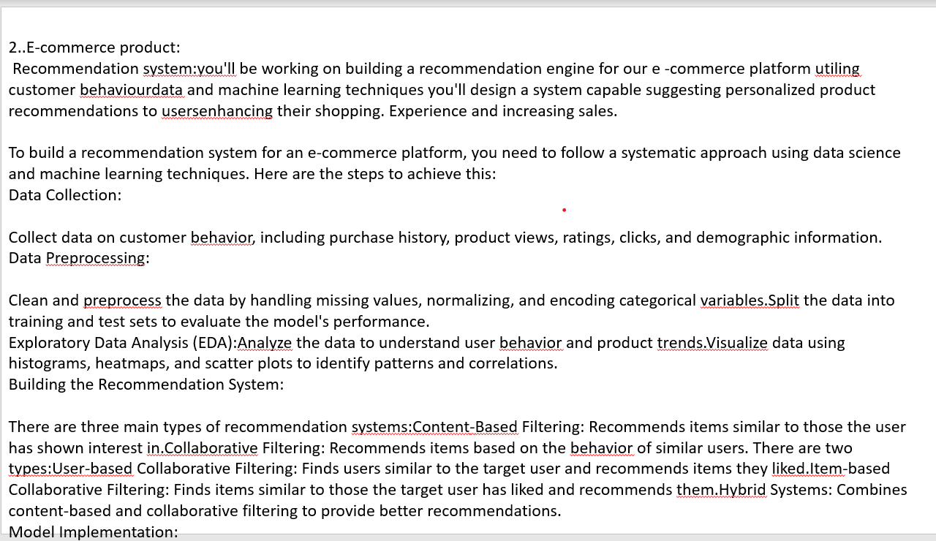

Slide 2
Continuously monitor the system’s performance.Gather user feedback and improve the recommendation algorithms accordingly.Update the model with new data regularly to maintain accuracy and relevance.By following these steps, you can build an effective recommendation system that enhances the user shopping experience and increases sales on your e-commerce platform.

